Slide 1
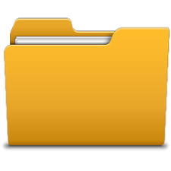
FILE MANAGEMENT

Slide 2

File management is an essential skill in digital literacy, ensuring that individuals can effectively organize, store, retrieve, and protect their files in digital environments. Understanding the principles of file management can improve productivity, reduce frustration, and make the digital workflow more efficient.

Slide 3
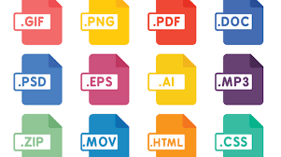
UNDERSTANDING FILE SYSTEMS
A file system is the way files are organized, stored, and accessed on a computer or digital device.
File Types: Files come in different formats (e.g., .docx, .pdf, .jpeg). Knowing the types of files you are working with helps in managing them properly.
File Extensions: The part of the file name that comes after the dot (e.g., .txt, .jpg, .mp4) determines what type of file it is. Recognizing file extensions helps in choosing the right software to open and manage files.

Slide 4

TYPES OF FILES
Before managing files, it's important to understand how to create them. Digital files can be created using various software applications based on their intended use.
Word Documents: For text-based files, applications like Microsoft Word, Google Docs, or OpenOffice Writer are used. These files may contain formatted text, images, tables, etc.

Slide 5

Spreadsheets: For organizing data, Excel, Google Sheets, or similar programs are used to create .xls or .csv files.
Presentations: For creating slide shows, tools like Microsoft PowerPoint or Google Slides allow users to create .pptx or .gsheets files.

Slide 6
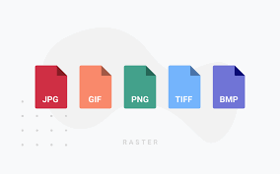
Images and Graphics: Programs like Adobe Photoshop, Microsoft Paint, or Canva allow users to create .png, .jpg, .svg, or .psd files for images and graphics.
Text Files: Basic text editors like Notepad (Windows) or TextEdit (Mac) create simple .txt files for storing plain text.

Slide 7
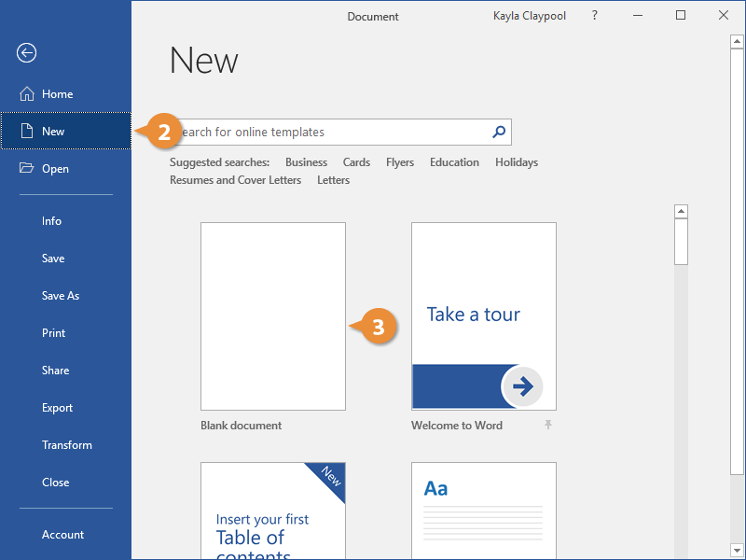
STEPS TO CREATE A FILE
Open the Relevant Application: Open the program you want to use to create your file (e.g., Word, Excel, PowerPoint).
Select 'New' or 'Create New': Most applications have a “New” or “Create New” option available in the File menu.

Slide 8
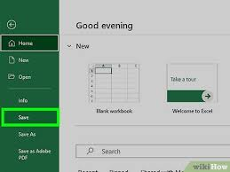
Create Your Content: Start adding your content, whether it’s typing in a Word document, adding data to a spreadsheet, or designing a presentation.
Save the File: After creating your content, save the file to a location on your computer or cloud storage. Give it a meaningful name that will help you easily identify it later.

Slide 9
PC
Windows:
In File Explorer, navigate to where you want to create the folder (e.g., in Documents or Desktop).
Right-click in an empty area, then select New > Folder from the context menu.
Name the folder by typing a name and pressing Enter.
Mac:
In Finder, navigate to the location where you want to create a folder (e.g., Documents or Desktop).
Right-click and select New Folder or press Command + Shift + N.
Name the folder and press Enter.

Slide 10
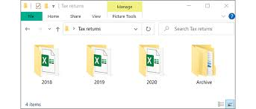
ORGANIZING FILES AND FOLDERS
Organizing files and folders is about creating a system that makes it easy to locate, edit, and share files. Effective file organization minimizes confusion and saves time.
Folder Hierarchy: Create a clear folder structure. Use main folders for broad categories (e.g., Work, Personal, School) and subfolders for more specific areas within those categories (e.g., Work → Reports, Work → Presentations).
Naming Conventions: Use clear, consistent naming conventions. Include dates, project names, or other relevant identifiers. For example, "2025_Sales_Report_April" is more efficient than just "Report1."

Slide 11

BENEFITS OF ORGANIZING DIGITAL FOLDERS
Easy Access: Organized folders help you quickly find work files, personal documents (like PAN, Aadhar, Passport), and financial records without wasting time searching.
Better Security: You can protect sensitive documents by password-protecting folders, keeping your personal and financial information safe.
Quick Backup: It's easier to back up organized folders, ensuring your documents are safe and can be restored if something goes wrong.

Slide 12

4. Efficient Collaboration: Sharing organized folders with others makes teamwork smoother, as everyone can easily find the right files.
5.Simplified Personal Management: Storing scanned copies of important documents (like bills, tax papers) in one folder makes managing your personal and financial tasks easier.
6.Always Have Copies on Hand: Scanned copies of important documents, such as IDs or passports, are easy to access and share when needed, like for travel or applications.

Slide 13
7. Disaster Preparedness: If physical documents are lost or damaged, you can access scanned copies stored digitally.
8. Environmentally Friendly: Less paper means more space and a cleaner environment.
9. Easy Updates: Digital files are easy to update, keeping your records current without losing older versions.
10. Simplified Legal/Official Processes: Having soft copies of important documents makes applying for loans or completing official tasks faster and more efficient.

Slide 14
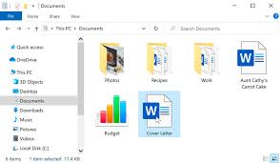
OPENING FILES
Windows:
File Explorer is the tool used to manage files and folders.
Open File Explorer by pressing Windows + E on your keyboard, or click the File Explorer icon in the taskbar.
Quick Access shows recent files and frequently accessed folders.
You can also open a specific folder by clicking This PC or Documents in the left sidebar.

